Slide 1
Using Quarto with Python
Lucas A. Meyer

Slide 2
Why Quarto

Slide 3
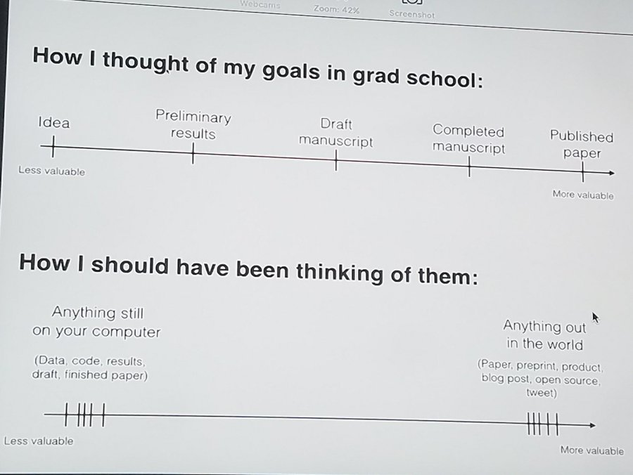
The content value chain
Content stuck in my computer is nearly worthless.
Goal
Move good content out of my computer as fast as possible
Reproducible
Git-based collaboration
Write once, generate:
  Code
  Paper
  PowerPoint
  Site/documentation
The content value chain by David Robinson (@drrob) captured by Amelia McNamara

Slide 4
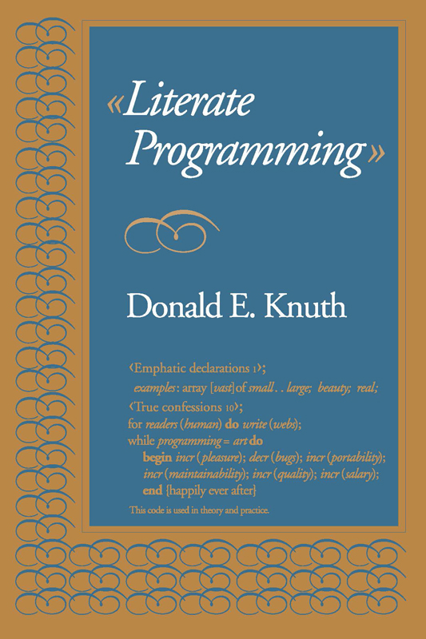
Literate Programming
Literate programming can help create high-quality reproducible, documented code.
Donald E. Knuth proposed literate programming in a 1984 article.
Jupyter implements the literate programming paradigm, but generating high-quality mass-consumable output (articles, websites) requires additional tools.
Donald Knuth’s Literate Programming

Slide 5
I tried many tools for Literate Programming
LaTeX
Needs extra tools like CWeb
Great for PDFs… Beamer for slides
Not great for websites
Dynamic content -> code in Latex
  \usepackage{ifthen}
  @for, @while
Python notebooks
Great, with Pandoc
Config separated from files
Word/PPT
Hard to collaborate before O365
Hard to reproduce / auto-generate
  code and writing separate
RMarkdown
Great for everything
Heavily dependent on R
New features in Quarto

Slide 6
Quarto
Quarto® is an open-source scientific and technical publishing system built on Pandoc.
The name “quarto” comes from the format of a book or pamphlet printed with eight pages of text, four to a side, then folded twice to produce four leaves.
The earliest known European printed book, the Sibyllenbuch (Gutemberg, c.1452), was done in the quarto format. Shakespeare’s plays, too!
With Quarto, you can:
Write Markdown and Python (or R, Julia, OJS)
Use equations, diagrams, citations, figures, etc.
Output articles, presentations, interactive websites…
Work with Jupyter Lab or VSCode
You can install Quarto on Linux, Windows and Mac.

Slide 7
Quarto workflow

Slide 8
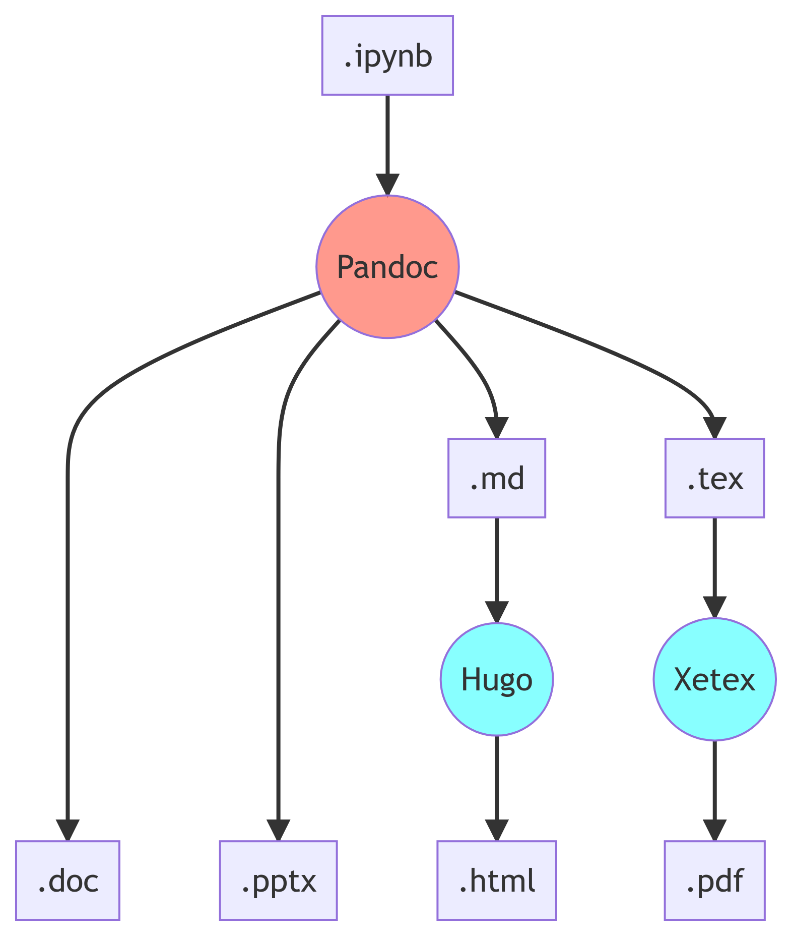
The content pipeline for .ipynb
About 75% of data scientists use Python through Jupyter notebooks.
With some scripting, you can use Pandoc on .ipynb files to generate papers, HTML, PowerPoint, etc.
You just need to learn Pandoc and shell scripting.

Slide 9
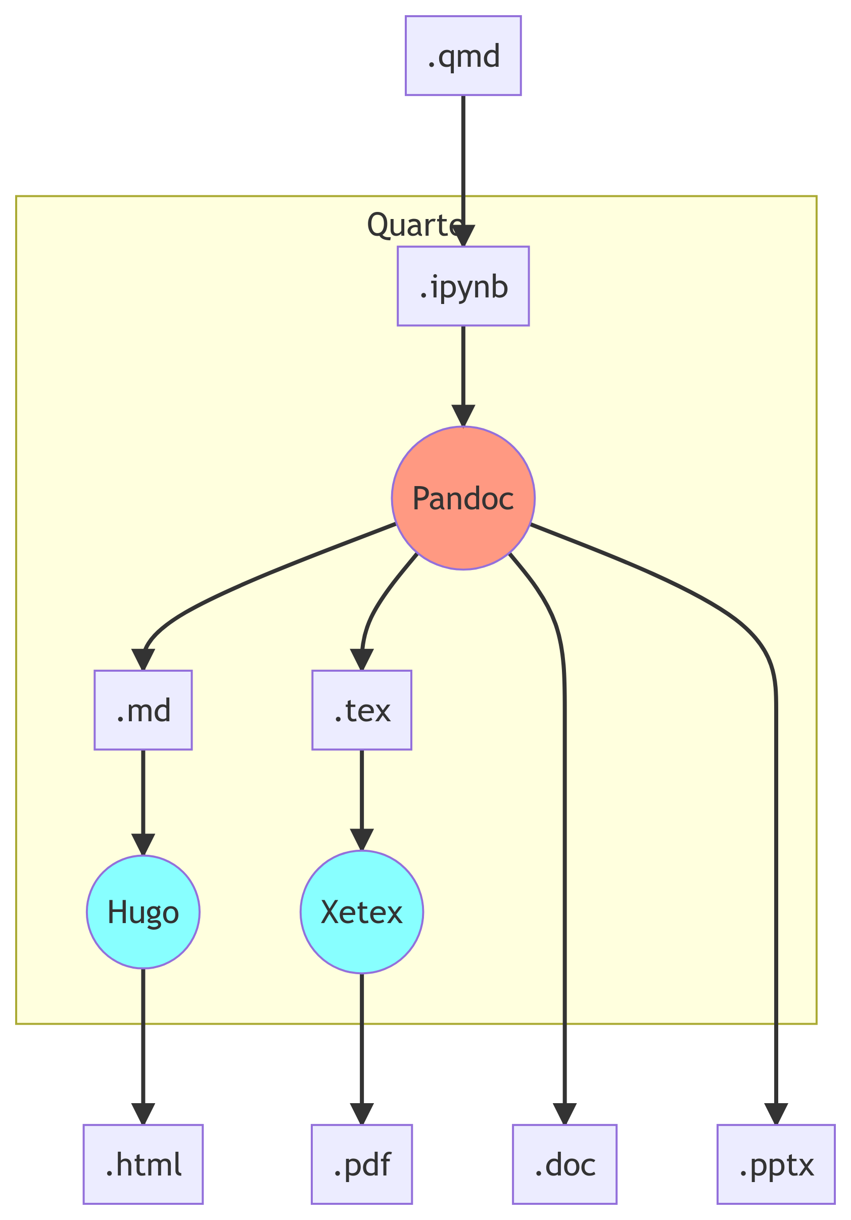
Quarto in Python, in a nutshell
All you need to use Quarto is to add some YAML (mostly simplified Pandoc configurations) to a .qmd file.
ipynb + YAML = .qmd.
This keeps the configuration and content in the same file. You can then render the outputs using quarto render <file.qmd> in the command line.

Slide 10
Using Quarto

Slide 11
The YAML front-matter
Quarto .qmd files always start with a YAML front-matter.
The YAML configuration determines what’s the output format of your document. A few popular output options are html, pptx, docx, and pdf.
You can use a single source file to generate multiple output types.
For example, the YAML on the right will generate a PowerPoint file and a Revealjs presentation.
---
title: "Quarto with Python"
format:
pptx:
reference-doc: templates/template.pptx
revealjs:
incremental: false
theme: pulse
author: Lucas A. Meyer
date: 2022-07-07
---

Slide 12
Main content
Writing content
Write content in Markdown.
Quarto’s Markdown supports figures, tables, bibliography, etc.
It also supports lots of extra features, like diagrams with mermaid and GraphViz, and even LaTeX equations:
$$E=mc^{2}$$
### Writing content
Write content in [Markdown].
Quarto's Markdown supports
figures, tables, bibliography, etc.
It also supports lots of extra features,
like diagrams with `mermaid` and
`GraphViz`, and even LaTeX equations:
$$
E = mc^2
$$

Slide 13
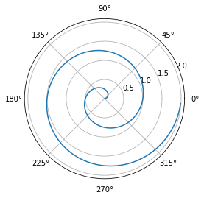
What if I want to add code?
The best thing about Quarto is that you can use it to run any code that you would be able to run in a Python notebook.
import numpy as np
import matplotlib.pyplot as plt
r = np.arange(0, 2, 0.01)
theta = 2 * np.pi * r
fig, ax = plt.subplots(subplot_kw=\
{'projection': 'polar'})
ax.plot(theta, r)
ax.set_rticks([0.5, 1, 1.5, 2])
ax.grid(True)
plt.show()

Slide 14
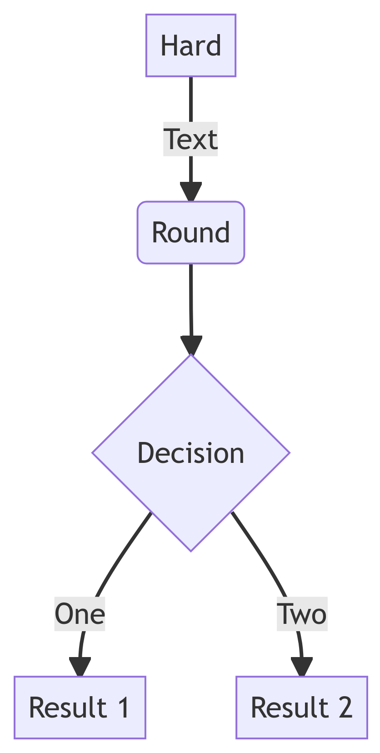
Diagrams
You can use mermaid to create diagrams.
The diagram in this and in previous sections were created with mermaid.
flowchart TD
A[Hard] -->|Text| B(Round)
B --> C{Decision}
C -->|One| D[Result 1]
C -->|Two| E[Result 2]

Slide 15
Regression and results
This code runs the first simple regression in Wooldridge’s Econometrics book.
$\text{wage}=α+β_{1}\text{educ}+ϵ$
# Load the data
df_wage = pd.read_csv("data/wage1.csv")
# Create an OLS model using R syntax
mod = smf.ols(formula="wage ~ educ",
data=df_wage)
# Fit the model
res = mod.fit()
# Show the results
reg_table = pd.read_html(res.summary().
tables[1].as_html(), header=0)[0]
display(Markdown(reg_table.
to_markdown(index=False)))
var | coef | s.e. | t | p-val
int | -0.9 | 0.68 | -1.32 | 0.19
educ | 0.54 | 0.05 | 10.17 | 0

Slide 16
Presentations in Quarto

Slide 17
Basic slide syntax
To create slides, you create sections with #, titles with ##, and bullets with -.
Content types
You can add several types of content
  code (use backticks)
  images
  diagrams
  tables
  etc.
## Basic slide syntax
To create slides, you create sections
with `#`, titles with `##`, and bullets
with `-`.
### Content types
- You can add several types of content
- code (use backticks)
- images
- diagrams
- tables
- etc.

Slide 18
Creating PowerPoint slides
To generate a presentation from a .qmd file, add format: pptx to the YAML front-matter.
Quarto will use the pandoc PowerPoint rules to render the content from the .qmd into .pptx.
The “pandoc rules” limit the flexibility to create PowerPoint presentations. Quarto has better presentation support for revealjs and beamer.
PowerPoint can use a template with only these layouts:
  Title Slide
  Title and Content
  Section Header
  Two Content
  Comparison
  Content with Caption
  Blank

Slide 19
PowerPoint layout rules
The rules are available at: https://pandoc.org/MANUAL.html#powerpoint-layout-choice
Title Slide: created from metadata fields like title and author
Section Header: created from the top-level headings (#)
Two Content: used when .qmd source contains :::: {.columns} and only text content. Previous slide is an example.
Comparison: same as “Two Content”, but content of columns is not text
Content with Caption: used when slide has non-text content, but no columns
Title and Content: whatever doesn’t fit the rules above.

Slide 20
PowerPoint templates
By adding a reference-doc entry to your YAML, you can tell Quarto (and pandoc) to use a file as a template for the format of your presentation.
The “Slide Master” needs to contain layouts named as per the previous slide (e.g. “Comparison”).
This allows you a lot of flexibility in the design of your slide deck, even if it is for just the small number of layouts that were listed in the previous slide.
You can control fonts, add background images, page numbering, etc.
---
title: "Using Quarto for everything"
format: pptx
reference-doc: templates/template.pptx
author: Lucas A. Meyer
date: 2022-07-14
---

Slide 21
Best feature: generate content dynamically
Let’s say you’re presenting a project about population dynamics but you don’t know which world leaders are coming to the conference.
On the presentation day, you learn that Italy, China, Brazil, India, Japan and Nigeria are attending.
You can use Python or R to automatically generate slides.

Slide 22
Generating slides with Python
The next slides/sections were generated using the code below:
df_dr = pd.read_csv("data/dr.csv.gz", compression="gzip")
df_pop = pd.read_csv("data/pop_brackets.csv.gz", compression="gzip")
years = [2000, 2025, 2050, 2075, 2100]
regions = ["Italy", "China", "Brazil", "India", "Japan", "Nigeria"]
for name in regions:
display(Markdown(f"## Age and Population Pyramids for {name}"))
display(Markdown(f'<div class="columns">'))
display(Markdown(f'<div class="column">'))
plot_dependency_ratio(df_dr[df_dr.Location == name])
display(Markdown(f'</div>'))
display(Markdown(f'<div class="column">'))
plot_population_pyramid_series(df_pop[df_pop["Location"]==name], years)
display(Markdown(f'</div>'))
display(Markdown(f'</div>'))

Slide 23
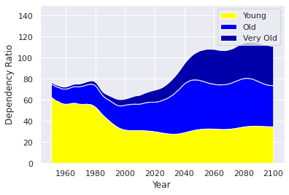
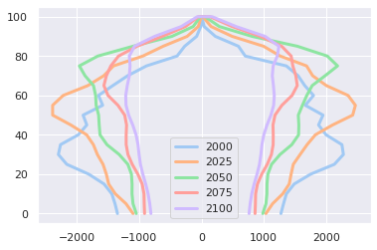
Age and Population Pyramids for Italy

Slide 24
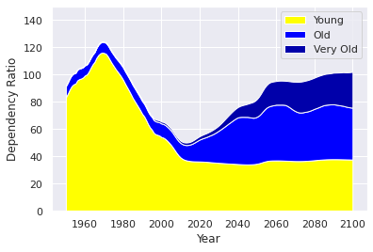
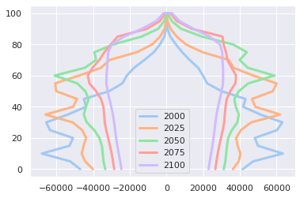
Age and Population Pyramids for China

Slide 25
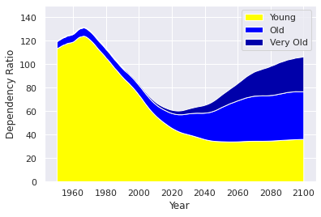
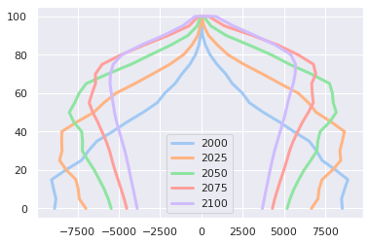
Age and Population Pyramids for Brazil

Slide 26
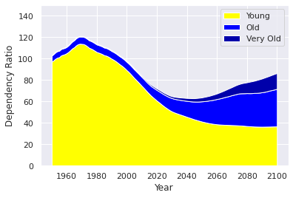
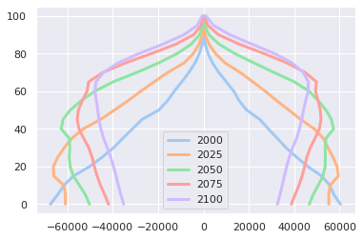
Age and Population Pyramids for India

Slide 27
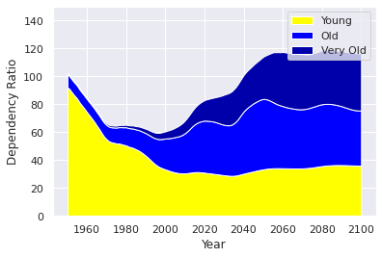
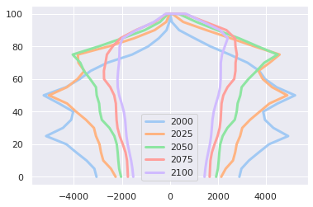
Age and Population Pyramids for Japan

Slide 28
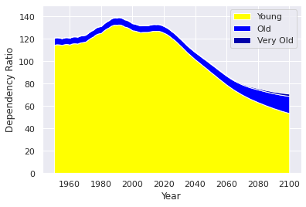
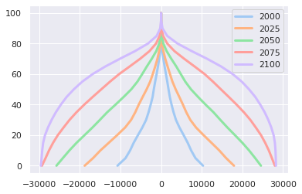
Age and Population Pyramids for Nigeria

Slide 29
Generating a website

Slide 30
Changing one line creates a website
---
title: "Quarto with Python"
format: html
# revealjs:
# incremental: false
# theme: [simple, revealjs-customizations.scss]
# title-slide-attributes:
# data-background-image: images/data-viz-bg.jpg
# data-background-size: contain
# data-background-position: right
author: Lucas A. Meyer
date: 2022-07-14
---
Adding or changing the format to html will create a website.

Slide 31
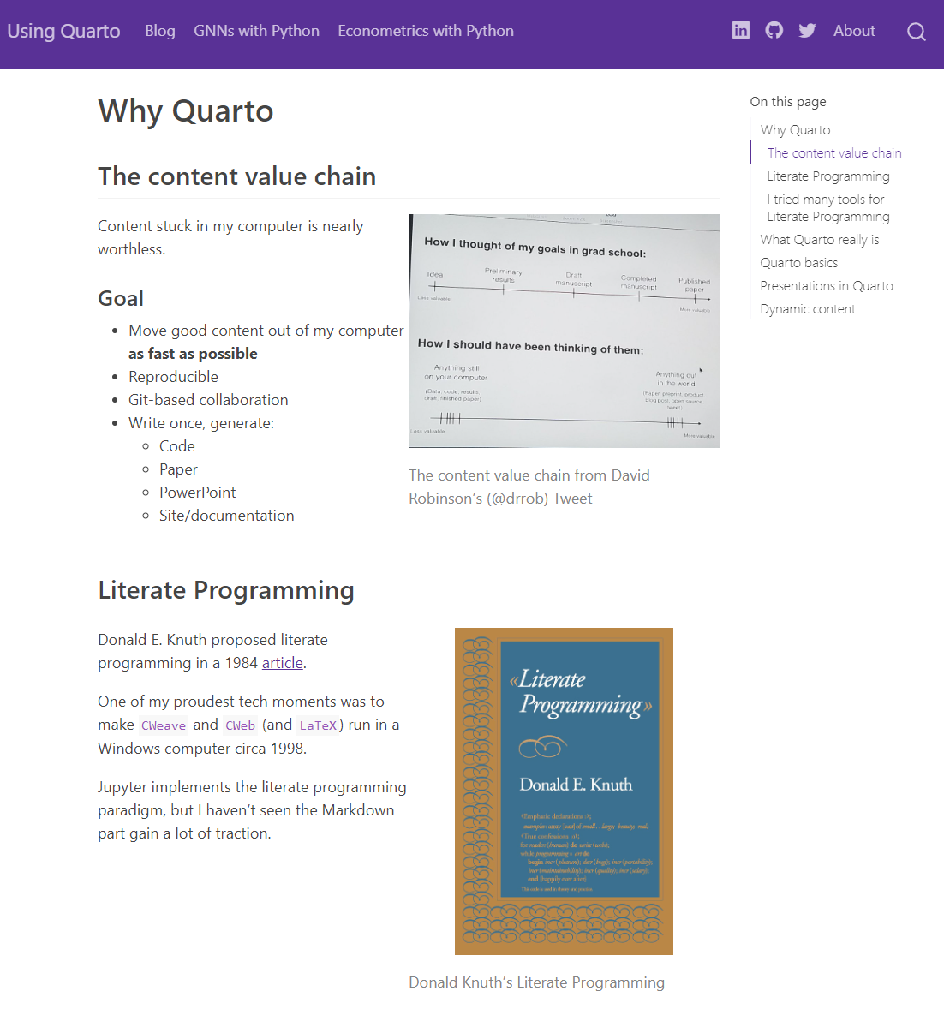
Screenshot of website

Slide 32
Scholarly articles

Slide 33
Writing scholarly articles
I reused some of the content of this presentation to create two scholarly-looking articles.
The purpose of the articles is just to show how easy it is to generate them with Quarto, they don’t contain original research.
Quarto adds cross-reference, citations and bibliography support to Markdown.
The relevant files are:
Quarto source file
Microsoft Word output
LaTeX PDF output

Slide 34
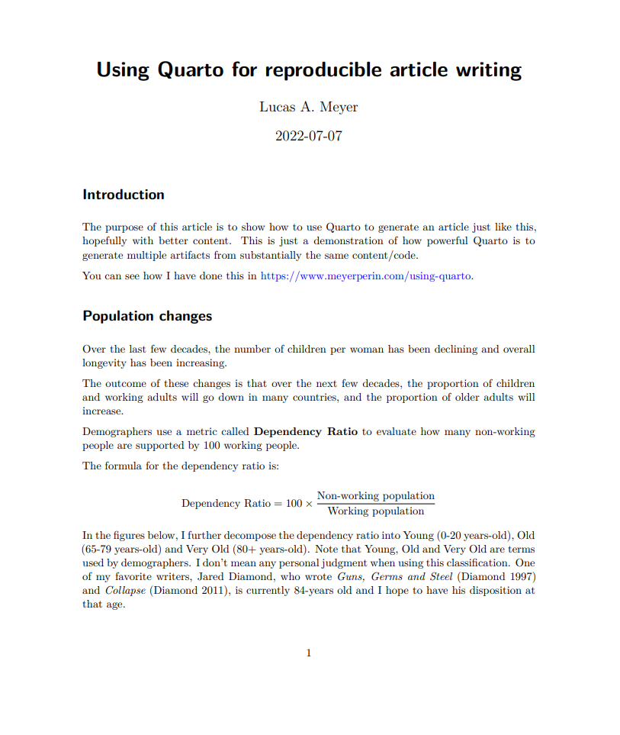
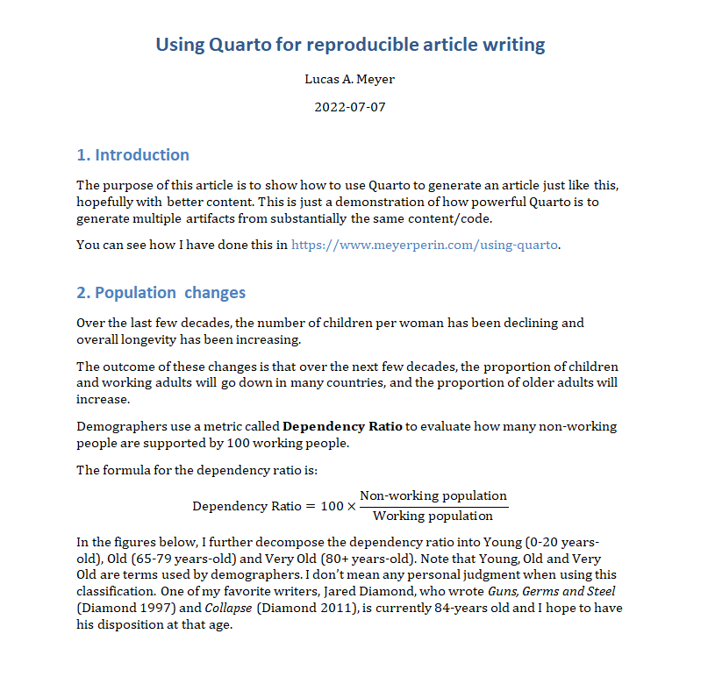
Scholarly article screenshots
PDF version of the article
Microsoft Word version of the article

Slide 35
Citations and Footnotes
Citations don’t work on presentations, but are easy to add to articles.
You need to reference a BibTex file in the YAML front-matter bibliography: references.bib. Quarto supports any of the 8000+ Citation Style Languages and will generate the “References” section automatically.
You can cite by using [@citation-name] in your text. Please check the article .qmd source and the PDF and DOCX outputs.
Generating footnotes is also easy. Using [^ref] links to a footnote, and [^ref: content of the footnote] generates its content¹.

Slide 36
Cross references
The Quarto guide has a great section on cross-references. I cover only the main points.
To create a cross-referenceable figure, section or equation, you need to tag it with its corresponding prefix, respectively “fig”, “sec” and “eq”.
To tag it, use the following syntax: #prefix-name.
For example, when declaring a figure, you can use:
![Elephant](elephant.png){#fig-elephant}
Later, you can refer to it using:
See @fig-elephant for an illustration.

Slide 37
Books in Quarto

Slide 38
Books in Quarto
You can also write books with quarto. From the same collection of .qmd files, Quarto can generate:
ePub
PDF
Online book
Two recent examples are:
Hands-on Programming in R, by Garrett Grolemund (source)
Python for Data Analysis, 3E, by Wes McKinney (source)

Slide 39
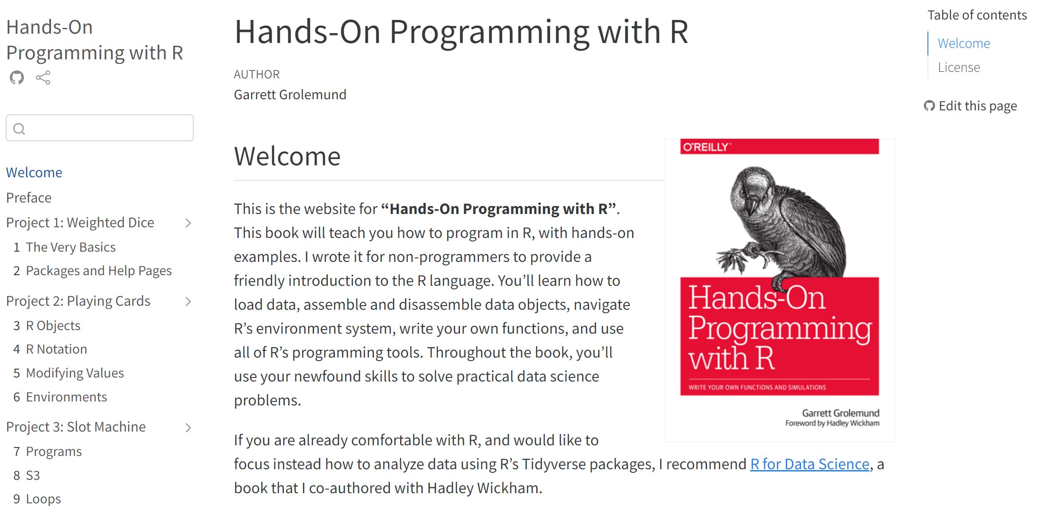
Hands-on Programming in R
This is a free book, and you can see the Quarto (source) that generated it.

Slide 40
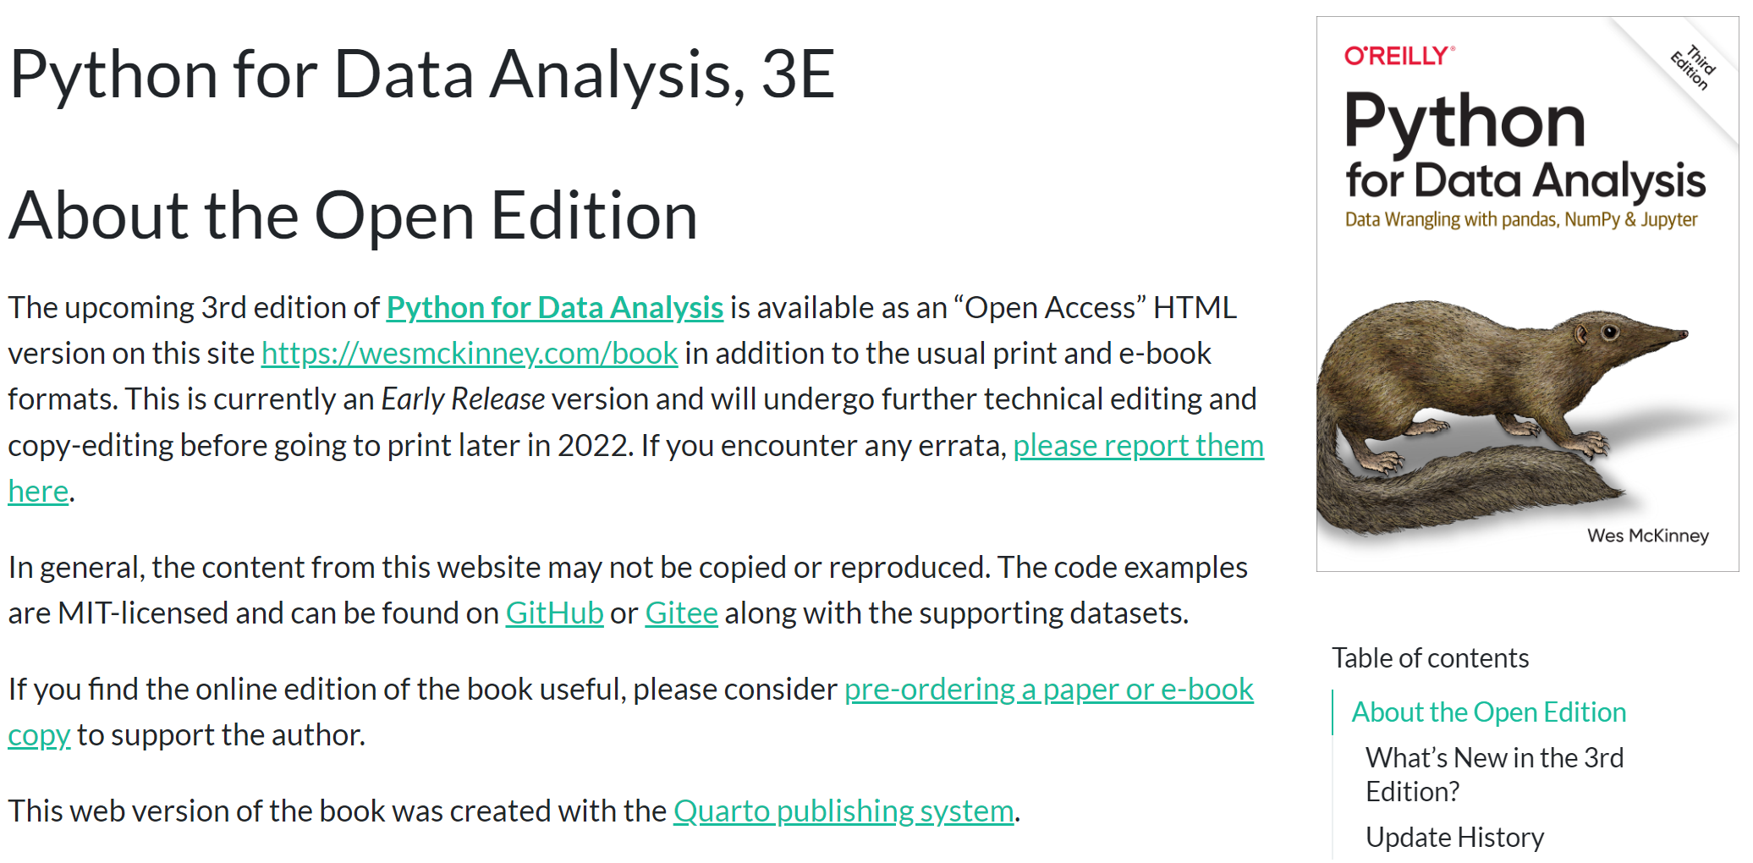
Python for Data Analysis, 3E
This is another free book, and you can see the Quarto (source) that generated it.

Slide 41
Should I use Quarto?

Slide 42
Where Quarto excels (July 2022)
Articles: maybe
I think Quarto® is more helpful for a team that already uses Git with Python notebooks or LaTeX to write articles.
Microsoft Word collaboration through SharePoint and Teams is easier than Git and Quarto… but it’s not reproducible.
Python notebook: excellent
Quarto adds features to Python notebooks without detracting anything. You just need a few YAML lines.
Blog: excellent
Quarto allowed me to have a scriptable, Python-based blog. I wrote code to post new articles to Twitter and LinkedIn.
Presentations: maybe
Great for RevealJS. For PPT, render process -> long edit cycle. Useful for:
a lot of dynamic content
Reproducibility needs
Collaborators used to Git/Beamer

Slide 43
Where to go next

Slide 44
Next Steps
The Quarto website has great tutorials:
  Jupyter
  VSCode
If you have multiple input files (e.g., blog or book), you can create a project. This allows rendering multiple files that link to each other.
  This also allows combining Python and R natively for the same project
  Some writers can use R, some can use Python, their content can link to each other as long as they’re in different .qmd files.
Projects can have pre-render and post-render steps in Python, R, Lua and shell script. I tend to use shell scripts that call other scripts.

Slide 45
THANK YOU

Slide 46
Notes
1. You can use footnotes in presentations and websites, too. In PowerPoint, they appear in the appendix.

